Slide 1
Inflation & Deflation
Consumer Price Index and its Impact

Slide 2



Inflation
As time goes on, economies grow in size and prices tend to increase.
Inflation is a general increase in prices across an economy.
As prices go up, our Purchasing Power declines.
Purchasing power is just our ability to purchase goods and services.
In other words, our money is not worth as much when inflation occurs.

Slide 3
Price Indexes
When economists attempt to measure inflation, they use a variety of Price Indexes.
A Price Index is a measurement that shows how the average price of a standard group of goods changes through time.
Price indexes help consumers, businesses, and the government make economic decisions.

Slide 4
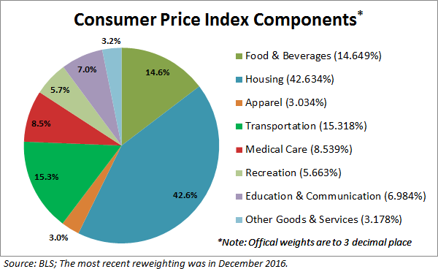
Consumer price index
The Consumer Price Index (CPI) is determined by measuring the price of a standard group of goods (the market basket).
This standard group of goods is called the Market Basket and is meant to represent the goods purchased by a typical urban consumer.
Notes:
Remind students to get down the various categories

Slide 5
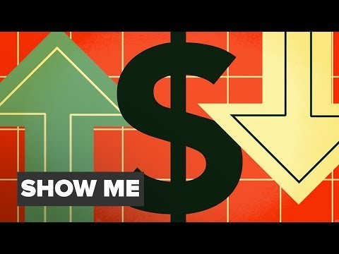
Notes:
Link to Investopedia video
Other link: https://www.youtube.com/watch?v=TALwNIM6gFI

Slide 6

Calculating CPI
To find CPI, the government compares current prices to a prices in a previous time period (Base period).
Formula: $\frac{current cost}{base−period cost}$ X 100
Example: Suppose todays market basket costs $360, but during the base period it costed $200. In this scenario:
$\frac{\$360}{\$200}$ X 100 = 180

Slide 7
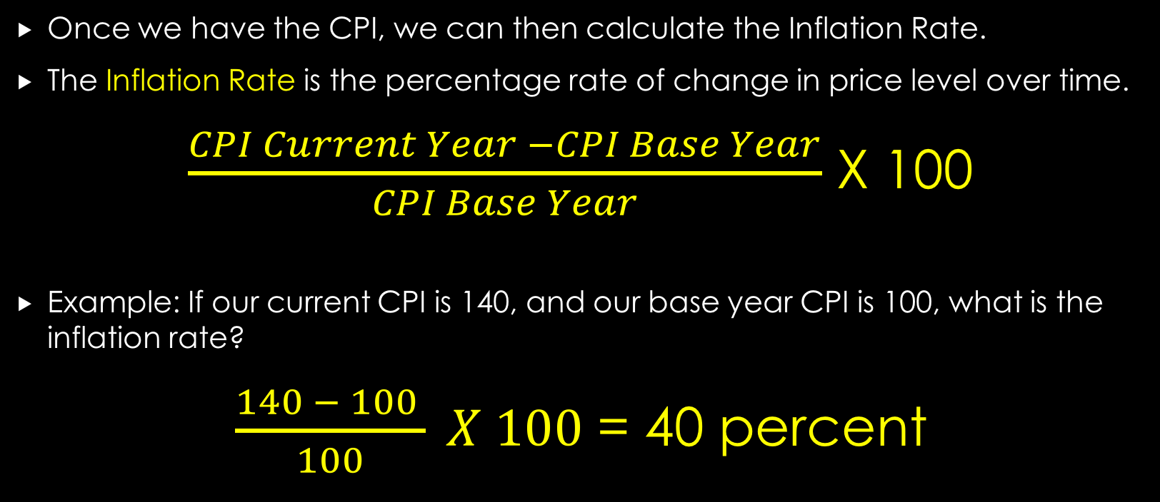
Calculating inflation rate
Once we have the CPI, we can then calculate the Inflation Rate.
The Inflation Rate is the percentage rate of change in price level over time.
$\frac{CPI Current Year −CPI Base Year}{CPI Base Year}$ X 100
Example: If our current CPI is 140, and our base year CPI is 100, what is the inflation rate?
$\frac{140 − 100 }{100} X 100$ = 40 percent

Slide 8
Possible day break here (?)

Slide 9
Types of inflation
Certain industries, such as food and energy, can have sharp spikes in inflation due to outside events around the world.
For this reason, economists developed the core inflation rate- the rate of inflation excluding the effects of food and energy prices.
THE WORST TYPE OF INFLATION: HYPERINFLATION
  Hyperinflation: Inflation that is out of control!
  Inflation rates can go as high as 100-500 percent per month.

Slide 10
Notes:
Link to Hyperinflation video
Other Hyperinflation Links: https://www.youtube.com/watch?v=h-7YCcZUXmw&list=PLh_EHnOyU3dNBDuJ2FS8PhqW6i6XLnCX1
https://www.youtube.com/watch?v=o5b618iV3tM

Slide 11
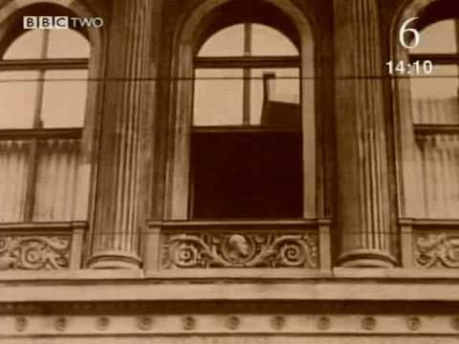
Hyperinflation in Germany

Slide 12
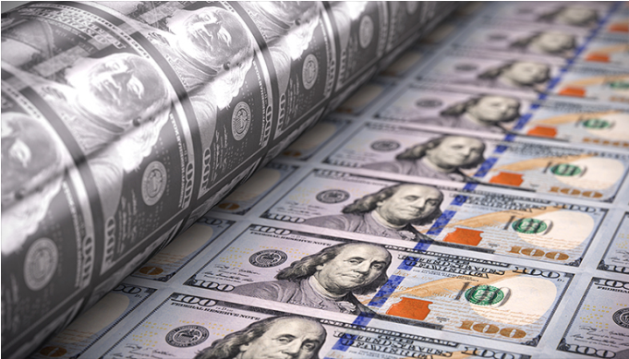
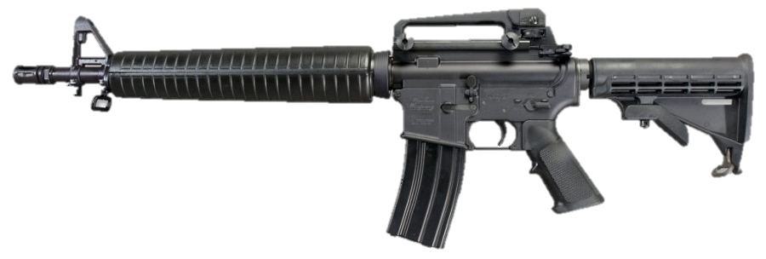
Causes of inflation
3 Major Causes of Inflation:
Growth of the Money Supply
  The quantity theory of inflation- Too much money in the economy causes inflation
  To maintain stable prices, the money supply must increase at the same rate as the economy grows.
Changes in Aggregate Demand
  Demand-pull theory: demand heavily outweighs supply, inflation can occur.
  Example: Heavy demand for weaponry during wartime.

Slide 13
Demand-pull theory: graph

Slide 14
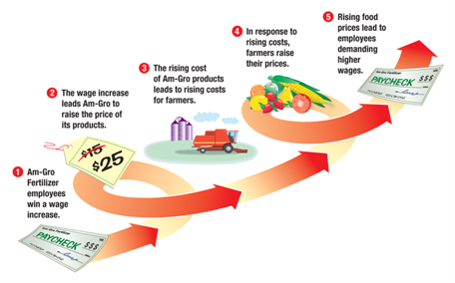
Causes of inflation
Changes in Aggregate Supply
Cost-push theory: When companies are forced to raise prices to compensate for increased costs.
  This often leads to higher wages for workers, but can turn out badly.
A wage-price spiral is a continual process where wages increase, causing prices to increase. This causes wages to increase, and the process keeps continuing.

Slide 15
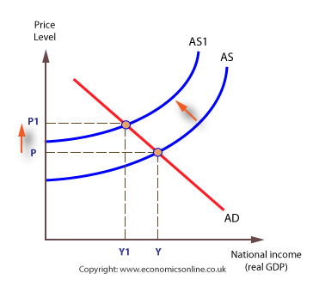
Cost-Push Theory: Graph

Slide 16
Effects of inflation
Impact of Purchasing Power
  When inflation occurs, prices go up and purchasing power goes down.
Impact on Income
  Most people have fixed incomes, and as inflation goes up, they cannot afford their usual standard of living.
Impact on Interest Rates
  If the inflation rate outweighs interest rates, savers lose money.

Slide 17
The opposite effect
The opposite of inflation is…
Deflation- the sustained drop in price level
Deflation is often caused by an increase in Unemployment and a decrease in capital investment.
Much more rare than inflation.

